Slide 1
Canada Life – Enterprise Data Hub Recommendations
April 2020

Slide 2

Table of Contents
Scope and Approach
Recommendations
Data Repository
Reference Architecture
Ingestion and Integration
Data Catalog
Next Steps
Appendix

Slide 3

Scope and Approach
Scope of service
High level reference architecture for data ecosystem
List of strategic criteria used for making recommendations
Validated recommendations for the overall data platform, with specific for data repository, ingestion, and data catalog
Approach
Due Coronavirus travel restrictions currently in effect, the work was delivered remotely
Week 1
Knowledge transfer, conducted through workshops (Virtual) facilitated by Cognizant team, focusing on business use cases and capabilities; current state architecture, recent evaluation results of data platforms and tools, review of existing relevant documentation and current state data processing workflows
Week 2
Customize the data reference architecture and solution alternatives definition to meet the Canada Life’s needs. It was conducted through working sessions amongst a smaller team and reviewed with key stakeholders from Week 1 workshops
Week 3-4
Incorporate all the feedback to finalize the reference architecture, and present to Canada Life. Recommendations will comprise of architecture components, their definition, possible solution alternatives and along with Cognizant’s point of view.

Slide 4
Approach for EDH Repository Recommendation
Activities
Methodology
Deliverables
Requirement understanding
Key methodologies
Key deliverables
Knowledge transfer from Canada Life on
Current State
Strategy & Road Map
Capability Framework
Data Hub Assessment findings
Vendor Capability Model
Cost Model & Other
Cognizant’s Data Modernization Assessment Models
Enterprise data hub repository recommendation with cost model
Assessment
Categorized Analysis into Segments
Repository
Data ingestion & Data Integration
Data Catalog & Governance
Defined Evaluation Criteria
Mapped evaluation criteria to user requested features
Weighted criteria
Had meetings with Canada Life teams, SME’s and other stakeholders
Consulted with Cognizant SME’s and technology experts across Data Practice to collect multiple view points
Validation against Cognizant's implementations in insurance & other relevant domains. Based on their experiences learned what works and what does not.
Recommended reference architecture
Ingest, Integration and Catalog recommendation
Evaluation Report
Performed Ranking & Scoring
Validated Ranking & Scoring & discussed methodologies used
Developed an assessment & scoring report to derive the recommended solution

Slide 5
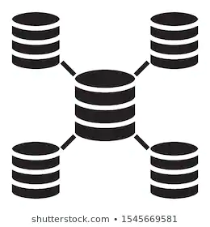


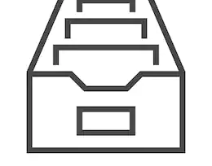
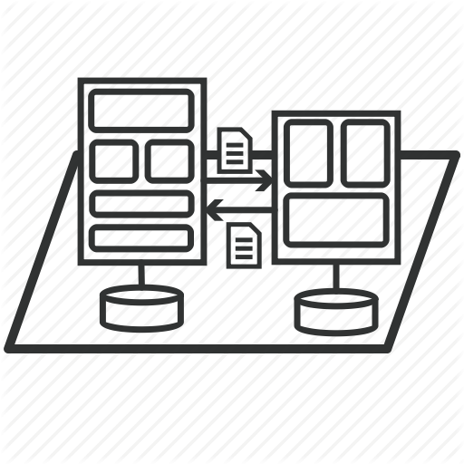
Cognizant recommendations
Data Repository
Reference Architecture
with key solution considerations
Ingestion and Integration
Data Catalog

Slide 6

Data Repository
Assessment criteria
Assessment criteria mapped against user requested features
Repository assessment dashboard
Annual cost assessment

Slide 7
Repository Assessment Criteria
Criteria | Wt. | Azure Score | Snowflake Score | CDP Score | Description
Cost (Run + Operational) & Resource Availability |  | 19 | 21 | 11 | Refers to the cost required to operate the platform
Operational Simplicity | 3 | 6 | 9 | 3 | Is the service easy to operate, maintain and manage in a cost effective manner; does it take a lot resource to operate it
Training & Resource Availability | 2 | 4 | 6 | 2 | Are multiple training options available that are trainee friendly and cost effective. Resource availability refers to availability of people with that skillset
Run Cost | 3 | 9 | 6 | 6 | The long run cost model is used here to leverage the PAYG model to minimize CapEx
Compatibility And Integration |  | 42 | 27 | 41 | Does it provide the ability to integrate with other tools and services to complete your use case. Is the integration easy or challenging
Bi, Insights & Reports Tools Integration | 3 | 9 | 6 | 6 | Does it provide BI and Insights or does it work with other tools/services easily to enable those capabilities. Does it adopt industry standards or its own custom standards
Data Engineering And Data Science Tool Integration | 3 | 9 | 6 | 9 | Ability to easily and intuitively design and develop data systems and be able to integrate with well-known data science tools
Data Governance(data Catalog. Data Lineage & Data Quality) Tool Integration | 3 | 6 | 3 | 9 | Does it provide or integrate with data catalog, data lineage and data quality tools to ensure data management & tracking
Integrated Development Environment | 3 | 9 | 6 | 9 | Refers to the ability of all aspects of development. Seamless integration is the key to high quality and speedy development
Orchestration | 2 | 6 | 4 | 6 | The ability of data movement along the data pipeline based on defined conditions and controls
Stored Procedures Support | 1 | 3 | 2 | 2 | Stored procedures are compiled sets of SQL commands that provide significant performance advantage over dynamic SQL statements

Slide 8
Repository Assessment Criteria
Criteria | Wt. | Azure Score | Snowflake Score | CDP Score | Description
Usability |  | 22 | 24 | 13 | Refers to the ease of use and customer satisfaction with the service
Customer Implementation And Satisfaction | 3 | 9 | 9 | 3 | Are customers satisfied and happy with service
Data Sharing | 2 | 4 | 6 | 4 | How easy is it to share data internally and externally without compromising integrity and access policies
End User Experience | 3 | 6 | 9 | 6 | Are the end users able to complete their work; is the experience pleasant; is it intuitive; is adequate help/support available
Security |  | 9 | 6 | 9 | The defense of a system/service against intrusion and unauthorized use of resources; the ability of a service to provide, privacy, confidentiality and integrity
Security | 3 | 9 | 6 | 9 | The defense of a system/service against intrusion and unauthorized use of resources; the ability of a service to provide, privacy, confidentiality and integrity
Performance |  | 23 | 30 | 23 | How a system performs in terms of responsiveness and stability under a particular workload considering time constraints and allocation of resources
Concurrency | 2 | 4 | 6 | 4 | Refers to the ability of a service to maintain performance level under increased workload; how many users can run their workloads at the same time without losing performance
Data Access Pattern Support | 2 | 4 | 6 | 4 | How does the service react to the change in demand patterns; does it require understanding of access patterns so that data can be distributed appropriately
Elasticity | 3 | 6 | 9 | 9 | The ability of a system/service to adapt to workload changes by allocating and de-allocating resources automatically, so that the available resources match the current demand as closely as possible
Performance | 3 | 9 | 9 | 6 | Support for Multi Parallel Processing and in-memory caching

Slide 9
Repository Assessment Criteria
Criteria | Wt. | Azure Score | Snowflake Score | CDP Score | Description
Reliability |  | 34 | 40 | 36 | The ability of a service/system to be available whenever requested and repeatedly perform at the same expected level, even in adverse conditions
Time Travel Querying (Data Flashback) | 1 | 1 | 3 | 1 | A Snowflake feature, enables accessing historical data (i.e. data that has been changed or deleted) at any point within a defined period
Data Storage Archival, Compression And Cloning | 2 | 4 | 6 | 4 | Data archival is provided by all platforms. But Snowflake provides Zero Copy Cloning, meaning share data with others without actually creating another copy of it
Multi-cloud Availability | 2 | 2 | 6 | 6 | Ability to migrate the workload to a different cloud platform, cost effectively. Helps avoid vendor lock-in; available in Snowflake and CDP
Service Availability And Replication Support | 2 | 6 | 4 | 6 | Refers to the service being available in different geographic locations and be able to replicate it to those locations, e.g., Synapse Analytics and CDP are available in Canada East and Canada Central, whereas, Snowflake is only available in Canada Central
Support Model/SLA’S | 3 | 9 | 9 | 9 | Availability of different levels and types supports models available and the SLA’s refer to how quickly will the vendor respond and via which medium, e.g., phone, email, etc.
Upgrade Process | 2 | 6 | 6 | 4 | How and when upgrades will be performed, will it disrupt/downgrade the service; do they have any availability zone pairings
Vendor Viability | 2 | 6 | 6 | 6 | How reliable is the service vendor; what kind of track record does it have; what support models it has
Data Sourcing Flexibility |  | 15 | 10 | 15 | Ability to accommodate different data sources and types, velocity and volumes
Continuous Data Load | 2 | 6 | 4 | 6 | Can it handle data streams, IoT streams, data variability, velocity and volume
Supported Data Formats | 3 | 9 | 6 | 9 | Can it handle different data formats, e.g., structured, semi-structured, unstructured
Roadmap |  | 6 | 6 | 6
Innovation & Continuous Improvement | 2 | 6 | 6 | 6 | Does the vendor continuously strive to improve its service; does it provide new features; does it keep up with new paradigms and innovations

Slide 10
Repository Assessment Criteria against to user requested features
Item # | User feature Description | Summary Criteria
1 | Supports self-service data engineering development cycle including ingestion, curation, publication of data allowing users choice on data engineering toolsets based on experience and preference (e.g. plug ad play SQL/R/Python, notebooks, graph, etc.)​ | Usability | Compatibility And Integration
2 | Supports secure integration and connectivity to broad range of self-service analytics and data science tools that are able to leverage the processing and storage power data that remains securely hosted, governed, and resident in the hub​ | Compatibility And Integration
3 | Supports secure integration and connectivity to broad range of self-service reporting, discovery tools and report visualization that are able to leverage a centralized publishing hub where data can be governed and trusted (e.g. data is no longer exposed in EUC tools)​ | Compatibility And Integration
4 | Supports a friendly user experience with limited learning curve that allows for flexibility and choice based on the users level of experience and preference, including clear handling of error messaging and strong online user community support​ | Usability
5 | Supports a broad range of data security, audit, retention, and usage needs across jurisdiction, including who is accessing what data and securing areas with higher data access and security controls from other security zones. Need centralized integration with our security (IA)​ | Reliability | Security
6 | Supports a broad range of data sources and types including batch, CDC/delta loads, unstructured data, real-time streaming, and messaging queues​ | Data Sourcing Flexibility
7 | Supports easy migration and integration as technology ecosystems evolves, to promote time to value and prevent vendor lock in​ | Reliability
8 | Supports integration with unified metadata/cataloging tools like Collibra to allow users to easily search and find data (structured and unstructured) and understand what happened to the data along its journey​ | Compatibility And Integration
9 | Supports storage and search of larges amounts of data in native formats like ASCII/EBCDIC/JSON/XML/unstructured​ | Data Sourcing Flexibility
10 | Supports integration data quality tools to ensure data consumers can trust the data they dependent on daily (reliable operational data)​ | Compatibility And Integration
11 | Solution supports innovation and continuous improvement allowing us to recruit and retain top talent from university and industry (e.g. popular best in class tools and integration points, vendor “university” training programs, etc.).​ | Roadmap
12 | Supports integration with code management tools to manage code use to build data assets​ | Compatibility And Integration

Slide 11
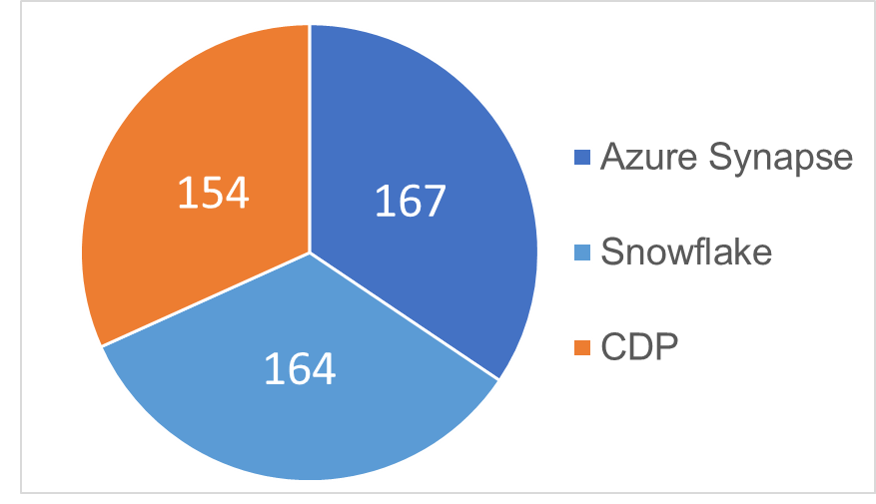
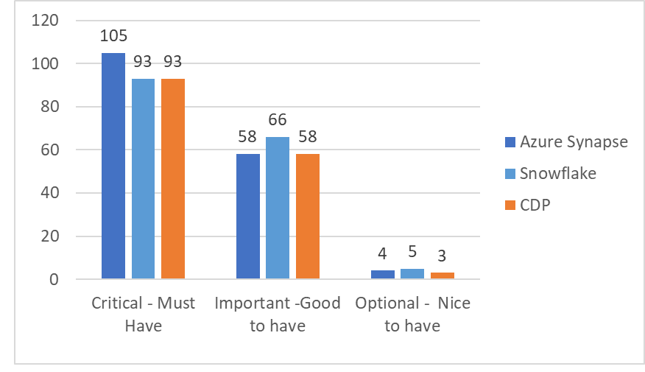
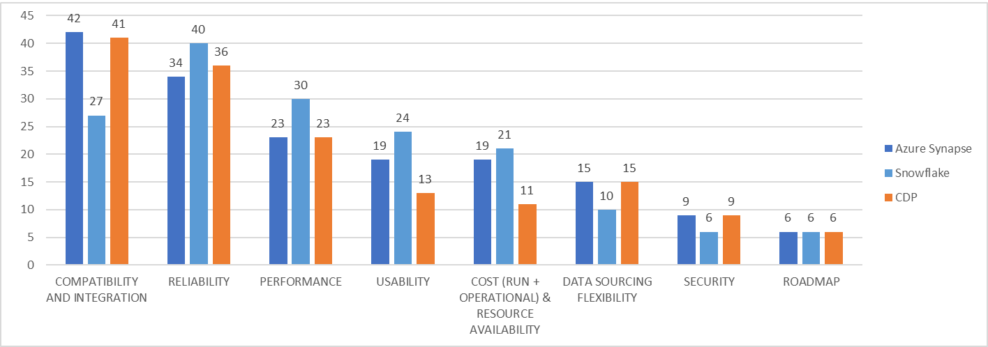
Repository Assessment Dashboard
Overall Scoring
Features Requirement Scoring
Key Highlights
Based on critical features, such as, Compatibility/Integration, Data Sourcing Flexibility and Roadmap, features requested by Canada Life for its EDH platform, Azure Synapse platform scores the highest
Criteria Analysis

Slide 12
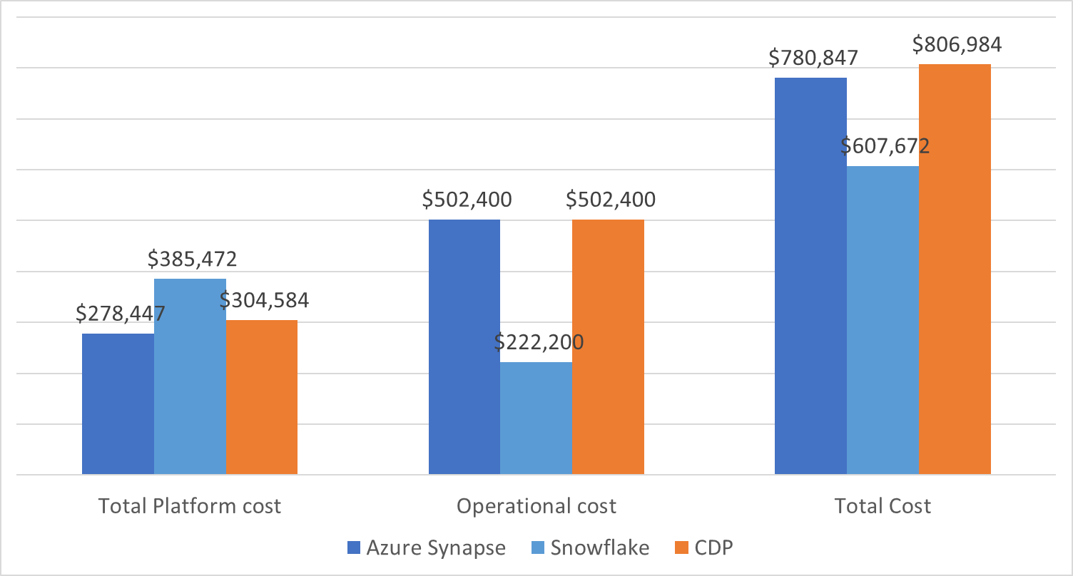
Annual Cost Assessment
Run Costs
Key Highlights
The operational cost for CDP and Azure Synapse is higher
The run cost for Snowflake is higher
The operational cost for Snowflake is the lowest and Synapse and CDP costs are equal
The total cost for CDP is the highest
Operational and Overall Costs

Slide 13
Cognizant findings
Synapse Analytics is a PaaS offering on Azure platform
Highly Performant on consumption end
Single tenant offering provides superior security controls
Integrated and Unified platform & experience
Azure Cloud Specific
Significant roadmap on Data Governance and Catalog
Moderate complexity on maintenance
Snowflake is a SaaS offering eliminates the need for managing IaaS and PaaS capabilities
Highly Performant on consumption end
Multi-tenant model offers less security controls
Decoupled storage and compute
Available on all leading Cloud platforms
No built-in functions or capability to support data catalog and data lineage directly
Easy to maintain snowflake, but maintenance of other supporting technologies also required
Cloudera is a good upgrade option for HDInsight Hadoop customers for big data workloads
Moderately performant on consumption end
Single tenant offering provides superior security controls
Integrated platform
Available on all leading cloud platforms
Well established Data Governance and Catalog as of today in market
Cloudera single pane of management console made things easier than prior CDH or HDP, but still multiple components to maintain.

Slide 14
Reference Architecture
with key solution considerations
Key Guidelines
Reference Architecture
Significant Design Considerations

Slide 15
Canada Life – Enterprise Data Hub - Architecture – Key Guidelines
Guidelines aligned to Canada Life’s requirements
Description
Architecture component
Responsive Data Architecture
Modular and layered data architecture
Decoupled storage and compute
Delivers Data in different Grains, Schemas & Temporal Values
Overall Architecture
Data Sourcing Flexibility
Support for various ingest patterns – Batch, Near-real time, Real time, CDC, push/pull
Allows for unstructured, semi-structured and structured data storage and analysis
Acquire
Self-Service Enablement
and Data Governance
Data Catalog provides:
Business glossary and technical metadata to enable self-service
Data Lineage and tracking
Analyze, Visualize & Publish
Unified Security Model
Native data security, authentication and authorization (Row, column level access control, dynamic data masking) model
Manage & Govern
Compatibility and Integration
Built-in Integration with various exploratory analytics and BI tools
Analyze, Visualize & Publish

Slide 16




















Enterprise Data Hub – Azure Synapse - Reference Architecture
Internal Sources
Acquire
Compute
Data Access
Visualize & Publish
Pull
ADF
Engineer
Analyze
Master data
Published
MF File Pull
ADF
Azure ML
2017
Azure ML
Synapse Analytics
Azure Analysis Services
Mainframe(MF)Files
Synapse Analytics
PowerBI
Landing
Batch
Polybase
Exploratory Analytics
Descriptive Analytics
Push
ERP (PPM, HR, Fin)
Metadata + Access Control + Governance
REST API
Blob Store
Manage
External Metastore
Azure Data Catalog
Enterprise Content Management
Curated
Published
Publish
Streaming Data
Raw
ADF
Persist
Operational
System(s))
Azure Event Hub
ADLS Gen2
ADLS Gen2
Synapse Managed Storage
Web App Services
CDC and Streaming
Storage
Archived
Other Sources
CDC
Push
Streaming Analytics
Blob Store
MIMIX Share
Azure Service Fabric
External Sources
Analyze
LEGEND:
- Non-Microsoft new tools
- Non-Microsoft existing tools

Slide 17
Enterprise Data Hub – Azure Synapse – Significant Design Considerations
Data Layer | Data Layer- Detail | Technology Options | Function
Landing |  | Azure Blob Storage | Point of entry for sources systems which push data Transient storage supporting file and database options “Life of Data” is limited to successful processing
Acquire | Batch RDBMS Pull Mainframe Pull Internal & external system Push | Azure Data Factory Syncsort DMX Data will be pushed to landing area in Azure Blob Storage | Azure data factory to connect RDBMS data source directly and pull data to Raw layer Syncsort DMX to read Cobol copy book and source data from mainframe to Raw Azure data factory 2.0 reads data from landing area loads to Raw
Acquire | Near to Real-time (CDC)/ Real time Event Processing | CDC Source - Syncsort MIMIX Share Realtime Event Data | Syncsort MIMIX Share will be connected to RDBMS or Mainframe to sync database DB log Syncsort MIMIX Share will publish data to EventHubs and Azure Data Factory will subscribe data and ingest to RAW Azure Data Factory 2.0 reads data from subscribes data from event hub and ingest to Raw
Raw layer |  | ADLS Gen2 | Acquires data directly from sources or Landing layer First point of data integration, acquires and processes data in real-time or batch mode Supports checks and balances Data granularity is close to the source, have different data management policies as compared to the warehouse.
Engineer | Batch and Near to Real-time(CDC) Processing | Azure Data Factory Azure Databricks Azure Synapse Analytics and Polybase | Data From Raw layer is standardized and integrated in the Curated layer using Azure Data Factory Databricks is used on complex integration & users' choice on use case Azure Synapse Analytics and PolyBase to be used for loading data to the Published layer
Engineer | Data Workflow | Azure Data Factory | ADF will be used for job orchestration

Slide 18
Enterprise Data Hub – Azure Synapse – Significant Design Considerations
Data Layer | Data Layer- Detail | Technology Options | Function
Curated Layer |  | ADLS Gen2 | Integrate data across sources and apply data transformation, aggregation logic, and business logic Primary layer which stores the integrated data
Published Layer | Data Warehouse | Azure Synapse | Dimensional Data at unified structure Aggregated and summarized dataset to optimize performance and enhance efficiency Snapshot of data for specific functional area Semantic layer to provide controlled data access and abstract technology from business
Archival Layer |  | Blob Store | Serves as historical data storage or data archival layer Low cost storage , may or may not support direct processing
Manage | Metadata and Data Governance | Azure Data Catalog and Collibra | Define policies around data ownership and data lineage Tool based/Customized metadata management across all layers to capture operational, business and technical metadata Supports metadata reports, including Business Glossary, Data Dictionary, Usage Analysis, Resource Utilization etc.
Manage | Access Control | Azure AAD and Azure Data Catalog | Authentication with Azure AAD and row and column level access control/authorization policies defined in Azure Data Catalog
Manage | Data Security |  | Encryption of data at rest and in motion with right techniques as recommended by Azure

Slide 19
Enterprise Data Hub – Azure Synapse – Significant Design Considerations
Data Layer |  | Technology Options | Function
Exploratory Analytics |  | Azure Databricks (ML) R Python DataRobot SAS Other tools | Provides data exploration and discovery capabilities including support for natural language Supports descriptive, predictive, prescriptive, customized and advanced analytics
Descriptive Analytics | Business Intelligence | Azure Synapse Azure Analytical Services Power BI | Generates standard, canned, pre-defined reports; ad-hoc, OLAP, slice and dice, drillable reports and dashboards
Streaming Analytics |  | Azure Databricks | Acquires data in real-time, manages profile data stores to action on events In-memory layer for Real-time action/output for further decisioning

Slide 20
Ingestion and Integration
Ingestion reference architecture
Ingestion Engine - Evaluation Criteria

Slide 21
Enterprise Data Hub – Azure Synapse – Ingestion and Integration
Internal Sources
Acquire
Compute
Data Access
Visualize & Publish
Master data
Pull
ADF
Engineer
Analyze
Published
MF File Pull
ADF
Mainframe(MF)Files
DMX
Azure ML
Synapse Analytics
Azure Analysis Services
2017
Azure ML
Landing
Batch
Polybase
Synapse Analytics
Exploratory Analytics
Descriptive Analytics
ERP (PPM, HR, Fin)
Push
PowerBI
Blob Store
Metadata + Access Control + Governance
REST API
Manage
External Metastore
Azure Data Catalog
Enterprise Content Management
Streaming Data
Raw
Curated
Published
Operational
System(s))
Publish
ADF
Persist
Azure Event Hub
ADLS Gen2
ADLS Gen2
Synapse Managed Storage
Web App Services
CDC and Streaming
Other Sources
Storage
Archived
CDC
Push
Streaming Analytics
Blob Store
Azure Service Fabric
External Sources
MIMIX Share
Analyze
LEGEND:
- Non-Microsoft new tools. May add additional costs
- Non-Microsoft existing tools. May add additional costs

Slide 22
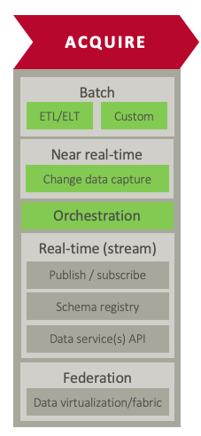
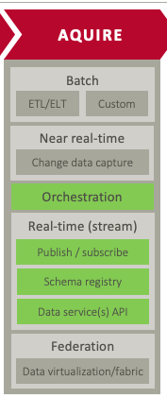




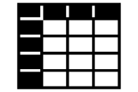


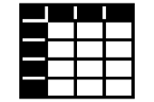

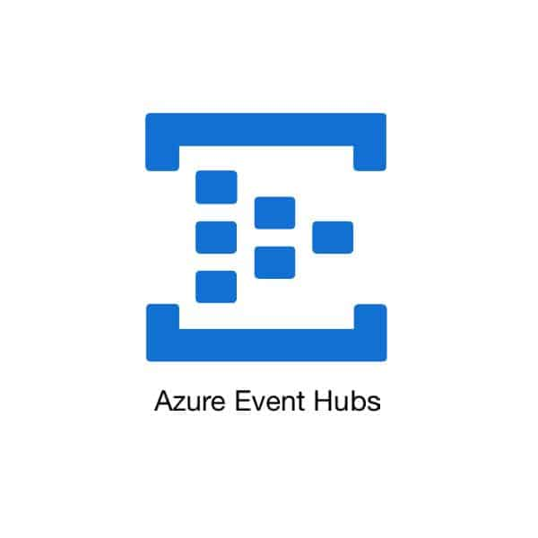
Ingestion – Reference Architecture
Metadata Driven ingestion is the industry standard methodology. Ingestion engine can be implemented via different technologies and tool sets
Batch
Streams
Ingestion Reference Architecture
Sources
Ingestion Framework
Targets
Batch
Metadata Configurations
RDBMS
Raw
Mainframe Files
Metadata Store
Ingestion
Landing Blob Store
Source & Target Connections
Data Extraction
Flat Files
Column Mapping
ADLS Gen2
Data Mapping
Rules
CDC
Data Delivery
MIMIX Share
Streaming
Ingestion Engine
Azure Data Factory | Syncsort DMX
Ingestion Engine

Slide 23
Tool Evaluation Criteria – Ingestion Engine
Criteria | Azure Data Factory | Syncsort
File Ingestion | 57 | 57
Database | 28 | 28
Mainframe | 0 | 45
API Calls (Real time/Batch) | 25 | 16
Streaming | 99 | 57
Customization | 21 | 8
Governance and Security | 22 | 12
Audit and Scheduler | 3 | 2
Egress | 16 | 12
Cloud Capability | 45 | 24
General | 30 | 14
Total | 346 | 275
Recommendation
Use Syncsort DMX non-Hadoop version on a VM for the mainframe ingestion only, due to its limited scalability. Use ADF 2.0, Databricks, Polybase, and Azure Synapse for the remaining ingestion & integration.

Slide 24
Data Catalog
Evaluation Criteria and Scoring

Slide 25
Data Catalog – Criteria evaluation
Functional Areas | Parameters | Weightage (1-3) | Collibra |  | Informatica (Axon+EDC) |  | Alation |  | IBM |  | Comments
 |  |  | S | WS | S | WS | S | WS | S | WS
Data Catalog | Business Glossary | 3 | 3 | 9 | 2 | 6 | 2 | 6 | 2 | 6 | Collibra has fully configurable meta model which enables capturing rich and custom Business Taxonomies
 | RDBMS Metadata Harvesting | 3 | 3 | 9 | 3 | 9 | 3 | 9 | 2 | 6 | Collibra has OOB connectors available for most RDBMS sources
 | ETL Metadata Harvesting | 2 | 2 | 4 | 2 | 4 | 2 | 4 | 2 | 4 | ETL metadata has different models in different ETL tools and is too verbose for Visual Consumption. Generally this requires custom builds and abstractions to be made usable
 | Data Lake Metadata Harvesting (Hdfs, Hive, ADLSGen2) | 3 | 3 | 9 | 3 | 9 | 3 | 9 | 2 | 6 | This can be done via Azure Data Catalog - AZUREDC2DGC solution
 | BI Metadata Harvesting (PowerBI, Tableau) | 3 | 2 | 6 | 2 | 6 | 2 | 6 | 2 | 6 | Collibra has OOB connector for Tableau and Power BI
 | Cloud Storage Harvesting (Azure Blob) | 3 | 2 | 6 | 3 | 9 | 2 | 6 | 2 | 6 | This can be done via Azure Data Catalog - AZUREDC2DGC solution
 | Cloud Database Harvesting (Azure Synapse Analytics) | 2 | 3 | 6 | 3 | 6 | 3 | 6 | 1 | 2 | Collibra has OOB connector for any source which can be connected through JDBC drivers which includes Azure Synapse Analytics
Data Governance | Policy Management | 3 | 3 | 9 | 3 | 9 | 2 | 6 | 2 | 6 | Business friendly UI and custom meta model to manage Policy metadata
 | Rules Management | 3 | 3 | 9 | 3 | 9 | 2 | 6 | 2 | 6 | Business friendly UI and custom meta model to manage Policy metadata
 | Process Workflow | 3 | 3 | 9 | 2 | 6 | 2 | 6 | 2 | 6 | BPMN 2.0 compliant Workflow framework to build and operationalize custom governance processes. 20 + OOB Processes also available
Data Lineage | Technical Data Lineage (Attribute/Column level) | 3 | 2 | 6 | 2 | 6 | 2 | 6 | 2 | 6 | Collibra has great Visualization features, but sourcing attribute level lineage data needs manual effort to extract and visualize at a level of abstraction that adds maximum value to end users.
 | Business Lineage and Traceability | 3 | 3 | 9 | 3 | 9 | 2 | 6 | 3 | 9 | Great Visualization features including interactive Diagrams to explore traceability
S - Score
WS – Weighted Score

Slide 26
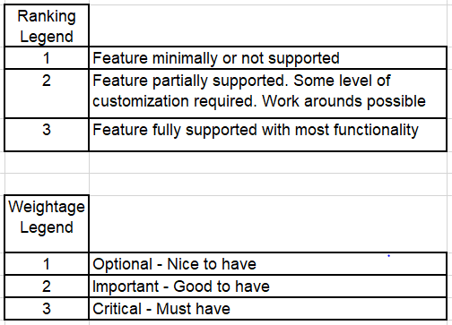
Data Catalog – Criteria evaluation
Functional Areas | Parameters | Weightage(1-3) | Collibra |  | Informatica (Axon+EDC) |  | Alation |  | IBM |  | Comments (Collibra)
 |  |  | S | WS | S | WS | S | WS | S | WS
GDPR | Data Discovery / Identify Sensitive data | 3 | 2 | 6 | 3 | 9 | 2 | 6 | 2 | 6 | Reference Lookups, Pattern based and Machine Learning enabled discovery features for Automatic Data Classification
 | Data Classification / Tagging/ Annotation | 3 | 3 | 9 | 2 | 6 | 2 | 6 | 2 | 6 | Automatic Data Classification and business friendly UI featurs to manage Tags
 | Tracking Data Usage - Data Events, | 3 | 3 | 9 | 2 | 6 | 2 | 6 | 2 | 6 | Custom Meta Model helps manage metadata across business and technology layers enabling tracking Data Usage.e.g. Usage per Business Process/Application
Data Marketplace | Business User Experience - Search/Explore/ Trust | 3 | 3 | 9 | 3 | 9 | 2 | 6 | 2 | 6 | Excellent Business friendly UI is Collibra's USP
 | Intelligent Facet Search | 2 | 2 | 4 | 2 | 4 | 2 | 4 | 2 | 4 | Features like Search Recommendations based on Weightages, Usage, Personas
 | Data Access Request | 3 | 3 | 9 | 2 | 6 | 2 | 6 | 2 | 6 | Data Acccess/Shopping Experience enabled through a combination of capabilities like cataloging, governance assets management and governance workflows
 | Crowdsourcing Metadata | 2 | 3 | 6 | 3 | 6 | 2 | 4 | 2 | 4 | Business friendly UI makes it easy to manage crowd sourced metadata like Tags, Ratings, Comments etc
Total |  |  |  | 143 |  | 134 |  | 114 |  | 107
S - Score
WS – Weighted Score

Slide 27
Components by Vendor

Slide 28
Canada Life – Enterprise Data Hub - List of components by vendor
Product Vendor | Product/Service
Microsoft | Azure Blob store (Hot, Cool, Archived) Azure Data Lake Storage gen2 (ADLS Gen2) Azure Event Hubs Azure Data Factory 2.0 Azure Databricks PolyBase Azure Synapse Analytics Azure Machine Learning service Power BI Azure Analysis services Azure Key Vault Azure Monitor
Collibra | Collibra® Data Catalog (Note: Azure Data Catalog is available in Preview/GA. If Microsoft can demo your use case, it should be given a serious consideration)
Syncsort | DMX MIMIX Share

Slide 29
Next steps…
Azure Reference Architecture Setup
Process, Controls and Team Setup
Complete contractual terms
Identify subscription services required
Organize subscriptions and resource groups for different environments
Active directory setup
ExpressRoute setup
Individual services (Synapse Analytics, Storage account, ADLSGen2, VMs, etc.) setup
More…
Define Roles & Responsibilities
Assemble team - Identify resources
Define Governance and Operating Model
Change Management Procedures
More..
1
2
Next Steps
Foundation components build
Pilot program
Ingestion framework with support for Change Data Capture (CDC)
Error handling framework
Audit balance and control framework
Metadata integration framework
DevOps for Data pipeline (DataOps) setup and framework
Identify use cases working with business/IT stakeholders. (Should be outcome based. Start with small and simple ones)
Implement a use case as Pilot Adopt an iterative approach
Document the process
Retrospect after each iteration and feed the process
3
4

Slide 30
Thank You

Slide 31
Appendix

Slide 32
Enterprise Data Hub – FAQs
Question: ADF vs. Syncsort – One of the questions was if we can already use Syncsort to ingest all the data sources MF(VSAM, DB2, IMS) and SQL Server, Oracle, DB2 LUW among others, why not use SYNCSORT to land it in the lake and then use ADF inside the data hub after this? This way all ingestions from traditional data sources are consistent.
Answer: Based on our implementation experience at our various customers, Syncsort is mostly used on the mainframe only. DMX non-Hadoop version is VM based & does not have distributed computing to execute across nodes. Bigger size DMX VM costs more compared to ADF. ADF does not have the mainframe connector. A small size VM based DMX non-Hadoop version should be sufficient for the mainframe ingestion.
Question. In the demo from Microsoft they showed both the data lake (Hadoop based) and the data warehouse working in conjunction. Is your implementation only the data warehouse component? Polybase was used to distribute the calls to the place where the data was stored, basically treating the lake and the warehouse like a distributed database. This allowed for the structured data and the unstructured data to be combined if required. Can you elaborate on your design and the functionality that is being delivered?
Answer: We want to look at the hub as a LakeHouse so that we take advantages of both lake and warehouse construct. We are seeing usage of this term LakeHouse in the industry more and more. As you have noted, data from the lake can be combined with the warehouse via Polybase construct and all the data across lake and warehouse will be available for doing analytics via the catalog/metadata layer. For data engineering, azure data factory will be used in conjunction with Databricks (between raw and curated) and Polybase (between curated and published). Hope this helps.
Question: New terms every day. Right now, we think of it as a Data Lake (Hadoop Microsoft Version) and a Warehouse where things end up for structured fast BI/Reporting/Dashboarding. In this case Syncsort has the ability to use the power of the lake for ingestions and transformation. Have you seen customers using this functionality like we did in the pilot effectively? It allowed for greater throughput on ingestions. Tying to a VM limits abilities. Again, DMX and DMX-H allow for the batch ingestions and remove a single machine limitation for doing the transformations, allowing for scaling. Looking for your insights on this, limiting to a VM seems old school batch oriented. What are your experiences using the DMX-H foundation at customers?
Answer: On Cloud, across the board, we are seeing native tools such as Azure Data Factory or AWS Glue or GCP’s data flow/fusion and other vendor data integration tools such as, Talend, Informatica, Matillion or Snaplogic that offers data integration PaaS. Customers want to and are utilizing what is native to the cloud platform due to its availability/simplicity than working out another contract and becoming dependent on another vendor. Syncsort is limited to ingestion and CDC scenarios like we have recommended here.

Slide 33
Enterprise Data Hub – FAQs
Question: Batch/CDC ingestions via ETL can post directly to the RAW area, thought landing area would be for passing files to and from that are not using the new ETL methodologies. Looks like Batch goes to Landing all the time which is not necessary and a waste of time if it is being passed through to the HUB. Can we get this reflected better? It is somewhat there but I think we should call it out.
Answer: The Landing zone is used for the File Push from internal and external systems. The remainder of the data lands in the RAW (ADLS Gen2) zone directly. It is reflected as such in the reference architecture.
Question: Archival layer we will want this to be searchable, we talked about ADLS GEN2 HOT, WARM and COLD all being searchable. Would like to understand where the BLOB is coming in except maybe the landing zone? Landing zone might be ADLS GEN2 and BLOG storage depending.
Answer: The archival layer is usually not searchable. It is used for the long-term storage only, maybe even on tape. Whenever there is a need for the archived data, a request ticket is generated specifying the date range, the audience and the purpose. The retrieved data is then stored in some kind of a staging area, when its purpose is served, the retrieved data is discarded.

